Slide 1


Partnership Self-Assessment Framework and Toolkit: Stronger Together
Homeless Link Partnerships Team

Slide 2







Background
The Partnership Team
Over the last 10 years Homeless Link has established trusting and long-lasting relationships and approaches with a range of statutory and non-statutory stakeholders across England, which has given us a strong footing in bringing a range of different partners together to tackle local homelessness challenges.
Sirea Jabar
Partnership Manager Yorkshire & Humber, North East, Lancashire & Cumbria
Jeremy White
Head of National Partnerships
Ellie Mullin
Partnership Manager South East
Steven Barkess
Partnership Manager West Midlands & North West
Chrystalla Karvella
Partnership Manager
London
Morgan Harries
Partnership Manager East of England
Mira Petrova
Partnership Manager South West
Notes:
As we know Ending homelessness requires coordination between many different agencies – including charities and housing associations, community and faith groups, local authorities, and other public services, as well as people with lived experience. We also know many areas joint working remains under-developed, dysfunctional, or absent. Too often this results in inefficient ways of working as efforts are duplicated or confused, while the needs of people who are experiencing homelessness remain unmet.
The toolkit has been supported with a series of roundtables which took place around the country with Homeless Link Partnership Managers.
Over the last 10 years Homeless Link has established trusting and long-lasting relationships and approaches with a range of statutory and non-statutory stakeholders across England which has given us a strong footing in bringing a range of different partners together to tackle local homelessness challenges. Our ability to convene organisations and individuals has paved the way for stronger partnership approaches to be developed and embedded across local areas and organically creates opportunities for linking up organisations to each other where appropriate, thus strengthening relationships across the sector.
Homeless Link is funded by the Department for Levelling Up Housing and Communities to support partnership development across England and from London Councils for specific work in the capital.

Slide 3
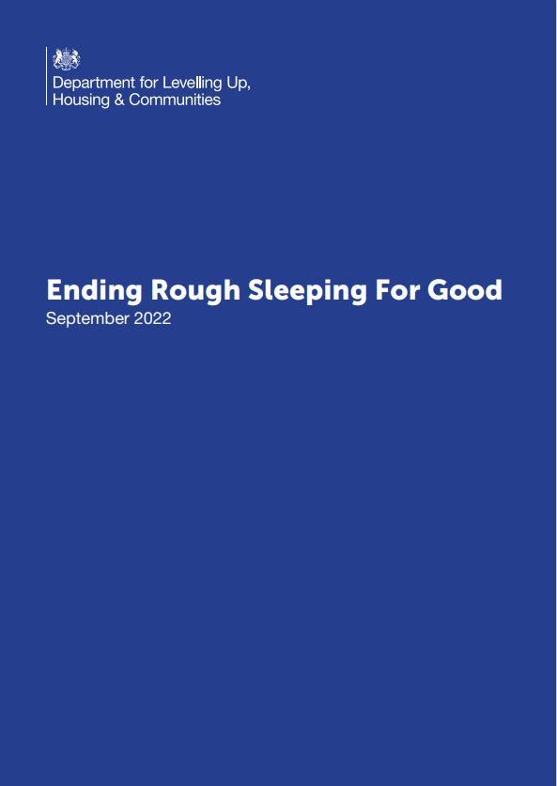

Background
Department for Levelling Up, Housing and Communities
Tom Preest, Head of Rough Sleeping Adviser Team
In September 2022, DLUHC launched a new strategy – ‘Ending Rough Sleeping for Good’. This underpinned the approach that Homeless Link's Partnership Team would take to preventing and end rough sleeping through the better coordination and joined up approaches of partnerships across England via developing a partnership self-assessment framework and tool.
Notes:
On 3 September 2022, the Department for Levelling Up, Housing and Communities launched ‘Ending Rough Sleeping for Good.’ It includes the commitment that Homeless Link will develop and enable stronger local strategic partnerships using a partnership approach to address barriers in local systems.
As a Partnerships Team, we developed, piloted and then recently launched a new Partnership Framework and Self-Assessment Toolkit to further
Support this work.
We carried out a series of roundtables consultations accross the country before we started developing the framework.

Slide 4


Self-Assessment Toolkit Aims
The Self-Assessment Toolkit is an opportunity for strategic leaders to better understand local challenges and form the basis of Local Partnership Plans to strengthen local collaborative working at a strategic and operational level.
Notes:
The Partnerships Self-Assessment is essentially a really good opportunity for strategic leaders to better understand local challenges and form the basis of Local Partnership Plans to strengthen local collaborative working at a strategic and operational level. The Self-assessment and subsequent action planning will require significant input from partners to ensure it is locally driven, locally owned, and has cross-sector buy-in to encourage participation from all relevant agencies.
So Some Local areas initially may not be aware that there is an issue with local Partnerships so within the toolkit we break it down into what constitutes an outstanding partnership and demonstrate how the toolkit can be a really useful and simple easy to use tool to help local areas identify strengths and gaps, and will enable them to start bridging those gaps. A local authority isn’t required to take the lead on the SA, it can be an existing forum or 3rd sector partner but it does need to be co-produced with partners.

Slide 5
Background
Principles of Partnership Working
The self-assessment toolkit is underpinned by a set of key principles and assumptions:
Good partnership working involving experts by lived experience will lead to the delivery of better services
Better frontline staff wellbeing will enhance service delivery and staff retention
Improved intelligence of the homelessness sector will enable more targeted and effective support offered to the sector
Stronger relationships and joint working improve service delivery and offers
Better services will positively impact people experiencing or at risk of homelessness
Notes:
This Self-Assessment Toolkit is underpinned by a set of key principles and assumptions about partnership working and the difference this will make to service delivery and outcomes for people using services.
So we spent a lot of time in defining these 5 key principles and took into consideration all of the feedback from the roundtable events, our own knowledge and experiences from working within local areas and we worked closely with consultancy team. And
We agreed that good partnership working needed to ensure that people with LE were involved and their voices were heard – so Good partnership working involving experts by lived experience will lead to the delivery of better services –
We felt that relationships and joint working were key to strenghting partnerships and areas should invest time and resources to creating platforms to enable those relationships to be nurtured and developed – so Stronger relationships and joint working improve service delivery and offers.
Staff welbeing on the frontline was also key to ensuring improved service delivery and staff retention - so Better frontline staff wellbeing will enhance service delivery and staff retention.
We agreed that better and supported services will positively impact on people experiencing homelessness. When services are working in isolation or silos then services are not nessecarilly developing or having as greater impact as they could do if working together. Also many smaller organisations can really benefit from that extra support and guidance from larger more established organisations. – So Better services will positively impact on people experiencing or at risk of homelessness.
And the final principle is around improving intelligence at local level. We already know that good data collection is vital in being able to identify and target resources and improve or create new services. – So Improved intelligence of the homelessness sector will enable more targeted and effective support offered to the sector.
.

Slide 6

Self-Assessment Framework
Partnership Markers
Marker Descriptions
Connectivity: Is required across operational and strategic levels to deliver solutions to prevent homelessness and rough sleeping
Clarity of Purpose: Underpins strategy and change, ensures that responses are organised and planned, and buy-in is achieved
Collaboration: Helps us to achieve the wider vision and purpose, bringing people and organisations closer together to problem-solve, share learnings, and make better use of resources
Co-Production: Collaboration between people with lived experience and those involved in delivering and commissioning services
Communication: Requires a good understanding of emotions and reactions to messages, ensuring appropriate use of language and recognising cultural differences

Slide 7
Self-Assessment Framework
How to Use
The Partnership Framework provides a tool for measuring partnership working and adopts a rating system from outstanding to excellent. The framework sets out indicators of what these ratings might look like.
Step 1: On the 'Markers' sheet, go through each marker rating yourself against the outstanding example offered. Your score for each marker and overall partnership score will be automatically calculated and displayed on the 'Overview' sheet.
Step 2: Note next to each marker examples of good practice and areas of concern.
Step 3: Record in the action plan activities to help improve or sustain partnerships. Actions that are overdue or due in the next 30 days will automatically appear on the overview page.
Notes:
Within the toolkit there are clear instructions on how to carry out the self asssment.
So step 1 would be go through each marker rating yourself against the outstanding example offered. Your score for each marker and overall partnership score will be automatically calculated and displayed on the 'Overview' sheet.
Step 2 – is to make notes against each marker highlighting good practice and areas of concern.
Step 3 would be to Record in the action plan activities to help improve or sustain partnerships. Actions that are overdue or due in the next 30 days will automatically appear on the overview page.

Slide 8
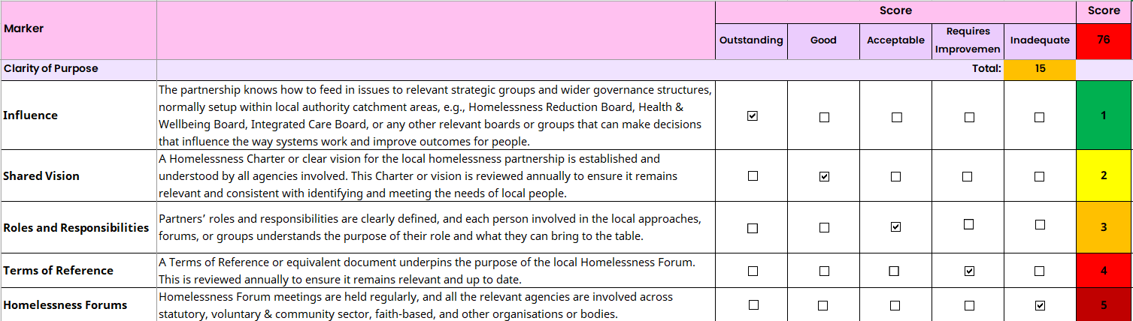
Self-Assessment Framework
Partnership Markers
Scoring System
Each of the five markers include a 5-point score on the scale of outstanding – inadequate for assessing partnership working. Clarity of purpose is used as an example of this below.
Notes:
This is an example of the scoring sheet. Scoring system – go through each point on the marker and score accordingly. The toolkit will automatically calculate the scores.
As you will see here, under the first marker which is ‘Clarity of Purpose’. There are 5 definitions under this marker to demonstrate what an outstanding partnership would look like. So for good clarity of purpose, a local partnership should demonstrate influence, it should have a shared vision, be really clear about roles and reesponsibilites, an up to date TOR should be inplace and homelessness forums should be meeting regularly and have a good reperesentation of all the relvent agencies.

Slide 9
Marker |  | Score |  |  |  |  | Score | Evidence of Good Practice | Areas of Concern
 |  | Outstanding | Good | Acceptable | Requires Improvement | Inadequate | 0
Clarity of Purpose |  |  |  |  | Total: | 0
Influence | The partnership knows how to feed in issues to relevant strategic groups and wider governance structures, normally setup within local authority catchment areas, e.g., Homelessness Reduction Board, Health & Wellbeing Board, Integrated Care Board, or any other relevant boards or groups that can make decisions that influence the way systems work and improve outcomes for people. |  |  |  |  |  | FALSE
Shared Vision | A Homelessness Charter or clear vision for the local homelessness partnership is established and understood by all agencies involved. This Charter or vision is reviewed annually to ensure it remains relevant and consistent with identifying and meeting the needs of local people. |  |  |  |  |  | FALSE
Roles and Responsibilities | Partners’ roles and responsibilities are clearly defined, and each person involved in the local approaches, forums, or groups understands the purpose of their role and what they can bring to the table. |  |  |  |  |  | FALSE
Terms of Reference | A Terms of Reference or equivalent document underpins the purpose of the local Homelessness Forum. This is reviewed annually to ensure it remains relevant and up to date. |  |  |  |  |  | FALSE
Homelessness Forums | Homelessness Forum meetings are held regularly, and all the relevant agencies are involved across statutory, voluntary & community sector, faith-based, and other organisations or bodies. |  |  |  |  |  | FALSE
Notes:
Would then need to demonstrate where an area is carrying out good practices and highlight where improvements need to be made.

Slide 10
Collaboration
Shared Learning | Learning needs are identified across the partnership and training, shadowing, and other learning opportunities are made available and shared with members and other agencies where appropriate.
Joint Action Planning | Operational forums are held with Multidisciplinary Teams and workable SMART actions are agreed. Partners are held to account and there are clearly identified links between operational and strategic groups or forums.
Reflective Practice | The partnership is holding reflective practice sessions to review the partnership's strengths and areas for improvement, as well as providing an opportunity for identifying any established and emerging good practice.
Identifying & Filling Gaps | The partnership identifies gaps in local service provision and responds by jointly bidding for new services where appropriate, sharing resources, and together exploring other funding/commissioning opportunities. New services are built that are evidence-based and filling gaps where needed.
Strengths and Skills | Partnerships are acknowledging the strengths and skills of all the members and utilising each other's experience to form relationships with formal partnership agreements in place where necessary.
Notes:
And then the same would be done with all of the markers.
This one is for collaboration. So for an outstainding level of collaboration a local partnership would need to demonstrate how they achieve:
Shared learning, joint action planning, reflective practice, identifying and filling gaps and utilising strengths and skills.

Slide 11
Connectivity |  |  |  |  | Total: | 0
Shared Opportunities | The partnership has an established relationship with relevant funders and local authority officers and commissioners. This includes open communication and information sharing regarding commissioning or new funding opportunities across the partnership. |  |  |  |  |  | FALSE
Working Groups | Working groups or action focused groups are in place which enable ongoing connections regarding opportunities for collaboration, funding, and solution focused discussions across relevant local agencies. |  |  |  |  |  | FALSE
Referral Pathways | Accessible and clear referral pathways are are in place and known to local agencies, which enable services to connect and work together to maximise positive outcomes for people experiencing homelessness and rough sleeping locally. |  |  |  |  |  | FALSE
Operational and Strategic Groups | Seamless and consistent connection exists between operational and strategic groups and functions and there are clear lines of reporting and accountability between the two. |  |  |  |  |  | FALSE
Joined Up Working | Silo working is minimised within agencies and all partners can demonstrate ways of effectively working in partnership with a positive external outlook. |  |  |  |  |  | FALSE | 0
Notes:
And then with connectivity its about how effective are opportunities for shared learning; are there working groups; Are referral pathwasy clear and accessible; Is there regular flow of communication between operational and strategic groups; are there opportunities for joint working.

Slide 12
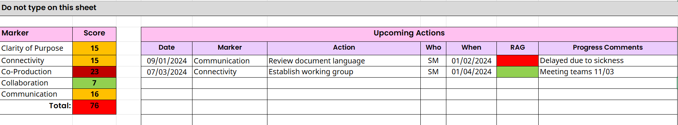
Self-Assessment Framework
How to Use
[NAME], Partnership Manager [Region]
Notes:
And then following the assessment and scoring there would be an appropriate action plan would be produced to address any areas that need improvement.

Slide 13
Breakout Rooms
Group activity – Self- assessment.
Read each definition under the marker in your group and discuss how you would score Sheffield against the outstanding example offered.
Score between 1-5 in the ‘score box’. 1 is outstanding and 5 inadequate.
Demonstrate the reason for your scores - note next to each marker, examples of good practice and areas of concern.

Slide 14
Next Steps
Set up a cross-sector partnership working group to complete the self-assessment and develop the action plan.
Further information will be circulated to the forum on how to get involved, either through the working group or feeding your views into the self-assessment.
The partnership will be kept updated on the development and outcomes from the Self-Assessment and Action planning.

Slide 15

What we do
Homeless Link is the national membership charity for frontline homelessness services. We work to improve services through research, guidance and learning, and campaign for policy change that will ensure everyone has a place to call home and the support they need to keep it.
Our training
We deliver in-house and public training courses to homelessness and related services across the country. Our courses are based on the latest policy, research and legislation, helping you develop the skills you need to tackle current issues and improve the service you offer to the people you support.
homeless.org.uk
@HomelessLink
Get in touch about training
James Cuming
james.cuming@homelesslink.org.uk
020 7840 4450
Laura Millward
laura.millward@homeleslink.org.uk
020 78404491

