Slide 1
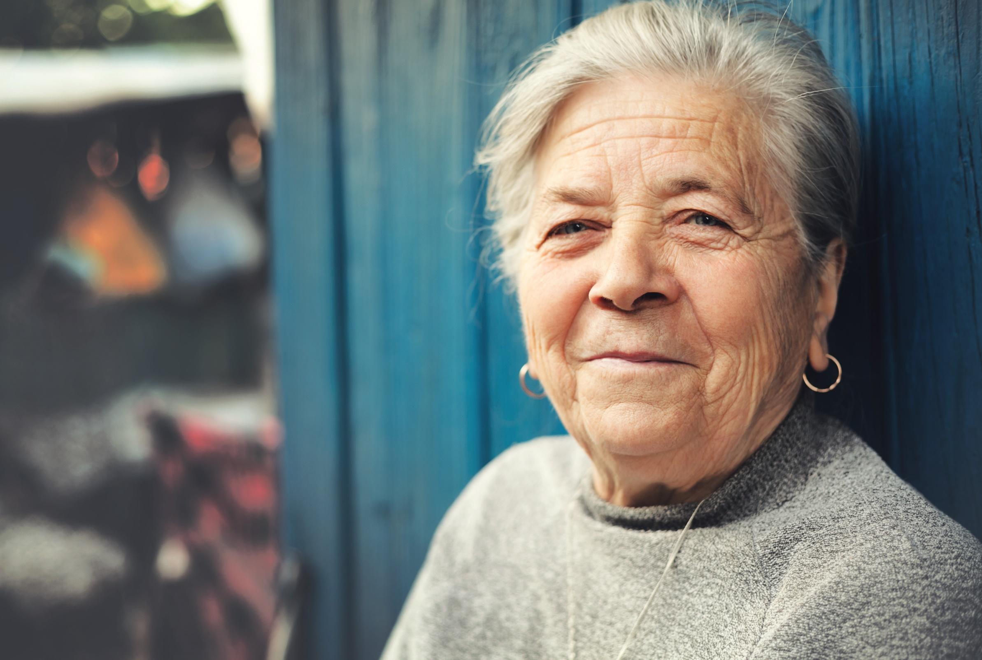
Supporting older women experiencing domestic abuse and at risk of homelessness
Chair: Lisa Raftery, Homeless Link, Grants Manager
Jayne Gentry, Safer Places, Director of Operations
Dickie James, Chief Executive, Staffordshire Women’s Aid

Slide 2
Responding to older women affected by Domestic Abuse
Jayne Gentry
Director of Operations
Safer Places
Notes:
Domestic abuse in later life is a neglected area in policy and practice when compared to the plethora of policy guidance, service development and professional training tailored towards supporting other age groups (Blood, 2004; ADASS, 2015). Although older people may experience similar attitudinal barriers as younger victim-survivors of domestic abuse do when accessing formal help (McGarry and Simpson, 2011), their experiences are further compounded by ageist responses from service providers (Harbison, 2008) or not having an understanding of co-ercive control and its impacts to an older person.

Slide 3
Who are Safer Places
Safer Places is an experienced specialist Domestic Abuse charity and for over 45 years have supported victims of DA
Early pioneers of the women's movement and opened our first refuge in 1976
Access to over 120 bed spaces of different specification over our portfolio
Community outreach support
Covering Hertfordshire and Essex

Slide 4
Domestic Abuse in the over 60’s
What the data says:
Older victims are more likely to be referred through the police (62% vs 60%)
Older victims are less likely to self- refer (10% vs 13%)
Whilst the majority of older victims are female there is a much higher level of older male victims (20% vs under 60 4%)
80% of older victims are not visible to services
4% of the national data set for IDVA’s in the UK are aged 61 or over
Notes:
Domestic abuse in later life is a neglected area in policy and practice when compared to the plethora of policy guidance, service development and professional training tailored towards supporting other age groups (Blood, 2004; ADASS, 2015). Although older people may experience similar barriers as younger victim-survivors of domestic abuse do when accessing formal help (McGarry and Simpson, 2011), their experiences are further compounded by ageist responses from service providers (Harbison, 2008) or not having an understanding of co-ercive control and its impacts to an older person. A UK study of people living in their own homes, estimated that over one-third of a million older people were subject to some form of abuse (O’Keefe et al., 2007).
However, the true extent of the problem remains unknown because there is significant under-reporting and under-recording of domestic abuse experienced by older people (McGarry and Simpson, 2011; Wydall and Zerk, 2015)

Slide 5
Domestic Abuse in the over 60’s
ONS have only just started collecting data for those over 60 – pilot findings will be released soon.
Victims aged 61+ are much more likely to experience abuse from an adult family member than those 60 and under. (41% vs 6% under 60)
Older victims are more likely to be living with the prepetrator after getting support. (32% vs 9% under 60)
Safe lives , Safer later lives report Oct 2016
Notes:
Similar to younger age groups, older people rarely access statutory agencies directly, in cases where domestic abuse is detected, it is usually a third-party report that discloses the abuse to statutory agencies (Wydall and Zerk, 2015). Often younger victims of domestic abuse will access specialist domestic abuse services from the third sector; however, as McGarry et al. (2014) highlight, older people do not appear to access support from these specialist services either. Consequently, older people are under-represented across both statutory and third sector service provision and thus these sectors have limited knowledge about older people’s needs.

Slide 6
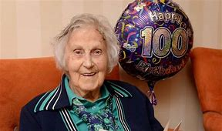
Born 1903 – 1929
Aged 91+
Married for life
Respect for authority
Women mostly in caring
roles
Notes:
This is marriage – sadly abuse is part of that – many will say “you made your bed, you have to lie in it”
When we spoke to older people they would witness their fathers treating their mother in this way – it is acceptable and sadly some of the women just laughed it off and said don’t worry about me.
Many of our victims advise that the only person they see is the perpetrator therefore if they are arrested who will visit – no- one therefore they do not disclose and hide the abuse.

Slide 7
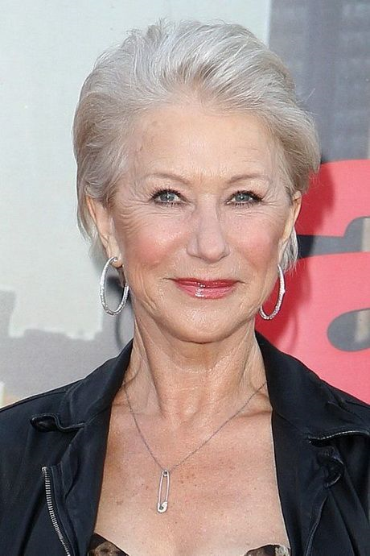
Born 1930 – 1947
Aged 73 – 90
The Silent Generation
Children seen and not heard
Divorce extremely rare
World War 2
Sacrifice
Notes:
State structures, such as retirement, limit access to financial opportunities at this stage in the life course for many older people. For most women born prior to the Second World War, financial dependency on their husbands as the traditional “breadwinner” reflects a widely accepted socio-cultural norm towards marriage and the differing conjugal roles for heterosexual couples (Wimberley, 1973). Thus, many older women within these age groups do not have their name on
importance on protecting the private family sphere, the home, from external interference
VOL. 19 NO. 5 2017jTHE JOURNAL OF ADULT PROTECTIONjPAGE 249
mortgagedeeds,relyontheirhusband’spensionanddonothavedirectaccesstothehousehold finances (ADASS, 2015).

Slide 8
Born 1948 – 1966
Aged 54 – 72
The Baby Boomers
Growing up in the 1960’s and 1970’s
Shifts in social attitudes
The Pill
Abortion legalised
First women's refuge 1971
Notes:
Are more likely to conceal domestic abuse within the family because the harsh reality of the situation conflicts with constructed ideals of family life and a woman’s role as a wife and mother
For a male older victims like their younger counterparts – abuse by their partner is not recognised as DA or reported due to fear of not being believed, What kind of real man allows himself to be abused after all they are the stronger sex right?

Slide 9
Types of relationships
Intimate partner – Long term “abuse grown old”
Intimate partner – abuse escalated
Intimate partner – new partner
Intimate partner – carer stress
Intimate partner – illness affecting the brain
Adult son-daughter
Grandchild
Multiple family members

Slide 10
Barriers to disclosure
Perception by older people is that services are for younger people
Generation/cultural/societal attitudes
Family dynamics
Health issues
Financial
Housing
Do not recognise their experience as DA
Isolation
Less likely to call 999
Notes:
Third party disclosers to the police
Whilst older victim’s dependency on abusers has been recognised as a significant risk factor (Kurrleetal.,1992)interdependency, where the perpetrator may also be dependent on the victim, is not always acknowledged within the feminist literature (Steinmetz, 1988). For example, as Clarke et al. (2015) note, financial and emotional abuse can occur where an adult son with a substance misuse problem is the sole carer for a parent. For victims in this context, a sense of parental responsibility to help their adult child with an addiction often supersedes their needs and rights as an individual (Sprangler and Brandl, 2007)
Would prefer to be visited by someone than nobody at all!
whilst most domestic abuse service responses are targeted at separating the victim and the perpetrator, for some older people, maintaining the relationship with the harmer is a priority, especially if they are an adult child. Moreover, severing family ties with the abuser(s) can lead to loss of access to grandchildren and subsequent social isolation (Flueckiger,2004).Cicirelli (2010)states that the risk of social isolation can also stem from the fact that social networks diminish in later life.

Slide 11
Disclosures
Hospital services are significantly more likely to have older victims than the local DA IDVA services
50+ victims account for 14% of a hospital IDVA caseload vs 10% of local victims
Adult social care play a key role – now a Core MARAC member
Housing
Visiting caring agencies

Slide 12
Recommendations
Provide in depth training for health professionals, care workers and council staff.
Older person IDVA’s
DA champions within adult services
Provision of DA services to
GP services (IRIS project)
Hospitals
Within mental health trusts

Slide 13
Support
Rebuilding Wellbeing
Validation of experience
Social networks
Financial stability
Assertiveness and boundaries
Longer term support
Notes:
Zink et al.’s (2006) research with older victims highlights a strong desire by victims to stay attached to social networks that have been developed over many years. Furthermore, research by Age UK (2014) indicates that older people place considerable emphasis on having family and friends in close proximity. Thus, in later life, service responses that lead to a reduction in social networks may not be considered a desirable option,as rebuilding socialties may be more difficult for older people than for other age groups

Slide 14
Older Women’s Voices on Domestic and Sexual Abuse
Dickie James
Staffordshire Women’s Aid

Slide 15
Staffordshire Women’s Aid and Comic Relief
Working with survivors of gender-based violence for over 45 years in Staffordshire.
Approach to domestic and sexual violence focusses upon gender, and our starting point is that Violence Against Women and Girls is both the cause and consequence of gender inequalities.
Comic Relief funding and research
Older Women’s Voices Project – our original motivation

Slide 16
Violence Against Older Women (VAOW)
Barriers to understanding the scope of VAOW:
Underreported – crime statistics
Under-researched
Contradictions in data (UK Office for National Statistics)
Confusion around definitions of abuse and of older women (United Nations)
Overlaps between elder abuse and domestic violence.
Stereotypes and popular assumptions about domestic and sexual violence
Confusion and overlap with Elder Abuse

Slide 17
MULTIPLE DISADVANTAGE
Societal norms around gender and aging.
Physical frailty or disability
Social Isolation (Rural Isolation)
Economic dependence
Health related control
Care of
Cared by
Barriers to health and mental health services

Slide 18
Violence Against Older Women (VAOW)
women over 60 appear to be under-represented as victims of domestic and sexual violence in police as well as Women’s Aid member services nationally.
in 2015, approximately 120,000 individuals aged 65+ have experienced at least one form of domestic abuse in England and Wales (Safelives).
Data from the Domestic Homicide Review (2016) for England and Wales show an increasing number of people aged 60+ are victims of domestic homicide
8% of the women killed by a partner or ex-partner in 2016 were aged 66 or over.

Slide 19
Research on specific health issues for older women living with domestic abuse
Increased likelihood of depression, anxiety and risk of suicide
Negative impact on cognitive functioning, such as memory lapses and difficulties with concentrating
Chronic pain, including bone and joint problems, digestive problems and high blood pressure
Substance misuse, such as heavy alcohol use, smoking and the use of prescription and non-prescription drugs
(Carthy & Holt, 2016)

Slide 20
Agencies working with older women.
Identifying/lack of awareness of Domestic Violence
Lack of awareness of appropriate interventions
Overlapping needs
Contact with specialist services
Lack of voice

Slide 21
The Voices Project and Ask Me
Consultation and Training with agencies
Consultation and Training with older women – Ask Me
Creating the Voices Group – making the invisible visible
Celebrating generational differences on International Day for the Elimination of Violence Against Women - Gwen

Slide 22
What we do
Homeless Link is the national membership charity for organisations working directly with people who become homeless in England. We work to make services better and campaign for policy change that will help end homelessness.
Homeless Link
Minories House, 2-5 Minories, London, EC3N 1BJ
020 7840 4430
Twitter: @Homelesslink
Facebook: www.facebook.com/homelesslink
© Homeless Link 2014. All rights reserved.
Homeless Link is a charity no. 1089173 and a company no. 04313826.

