Slide 1
2022 Workforce Survey
Key findings
Dr Trent Grassian
Research Manager, Homeless Link

Slide 2
2022 Workforce Survey
Overview:
May – June 2022
1,300 respondents
Mix of location, role, length in role, organisation type
Why a career in the sector
What it’s like working in the sector
Benefits and challenges of working in the homelessness sector
Skills & expertise needed
Current and projected challenges with recruitment and retention
How organisations have tried to address these challenges (and what’s worked)
What staff want to help their own career progression
Notes:
There are a lot of different ways people can enter the sector and many different avenues careers can take
To help the sector, we need to understand why people are working in the sector and the things that might cause them to stay or ‘exit’.
How we can keep good people from veering off into other careers?
6 main themes we looked at

Slide 3
2022 Workforce Survey
Participants’ roles:
40% frontline workers, as well as…
Service managers (18%)
Senior managers (15%)
Corporate / Central service, volunteers, trustees, and ‘other’
Time in role:
36% been in their role 5+ years
28% for 2 to 4 years
18% 1 to 2 years
18% <1 year
Notes:
Great to see such a high proportion from frontline and good representation across different lengths of time in role
7% Corporate / Central services
1% volunteer, 1% trustee, 11% other

Slide 4
1. Why…
do people choose a career in the homelessness sector?
“I will remain in the sector as long as my skills and experience are needed to make real change.”
Notes:
Motives for working in homelessness
Reasons less about the sector itself, more about their and organisational values
Similar trends across all roles
Though CEOs were more likely to indicate a desire to change the system and that it is an entrepreneurial sector
In addition:
Those more newly in their roles were more likely to cite values alignment and a pathway to a career in health / social care
Those in their role for 5+ years were the least likely to cite having lived experience as a reason

Slide 5
2. What…
is it like working in the homelessness sector?
It is rewarding: 89% agree
Frontline / support staff are appropriately paid: 16% agree
Enough opportunities to progress your career: 34% agree
Being under-staffed impacts our ability to provide
meaningful support to people sleeping rough: 78% agree
Notes:
The longer people had been in the sector, the more likely they were to disagree that there were enough opportunities to progress your career.

Slide 6
3. Why…
do people stay in the sector?
Notes:
Similarly, when asked about benefits of working in the sector, respondents mostly selected things that were about the impact of the work and individuals’ and organisational values, rather than the nature of the job itself
In nearly every category, those who had been in their role for a shorter time were more likely to cite benefits., especially in terms of: variety in how their career could progress and a rewarding career

Slide 7
3. Why…
might people leave the sector?
Notes:
But, while people see the main reasons to come into and stay in the sector as the values and desire to make a difference, the day-to-day working ‘realities’ present the biggest challenge.

Slide 8
3. Why…
might people leave the sector?
I don't expect I will have the chance to become a homeowner and raising a family on a low income is something that has contributed to my decision not to start one yet.
The cost of living crisis made me take a look at my role and pay and realise this isn't sustainable, I have more to offer and I can do good elsewhere for more money.
In the last 3 years I've had my contract extended 6 times. It's due to run out again in 2 months. It's very stressful not being on a long term contract and our service has lost staff because of it.
Notes:
Open response answers were generally focused on challenges with low pay (27%) and/or high workloads / long days (18%) leading to staff leaving and challenges with recruiting staff.
Challenges with inabilities to provide permanent contracts due to short-term funding (9%) were also prominent.
Staff discussed how this leads to needing to be constantly recruiting, which can take a significant amount of time and resources and
makes it harder to find and keep good people for short-term contracts.
Many also spoke of high workloads, stress and burnout

Slide 9
3. Why…
might people leave the sector?
A feeling that the work undertaken isn’t valued, [and] the work can often feel like it is a sticking plaster when much more is actually required to address the issues. Lack of recognition in both pay and training opportunities.
I feel at times that the homelessness sector relies entirely on the good will and passion of our people - this is not sustainable
Notes:
For many, it seems that over time, the challenges start to outweigh the ‘benefits’

Slide 10
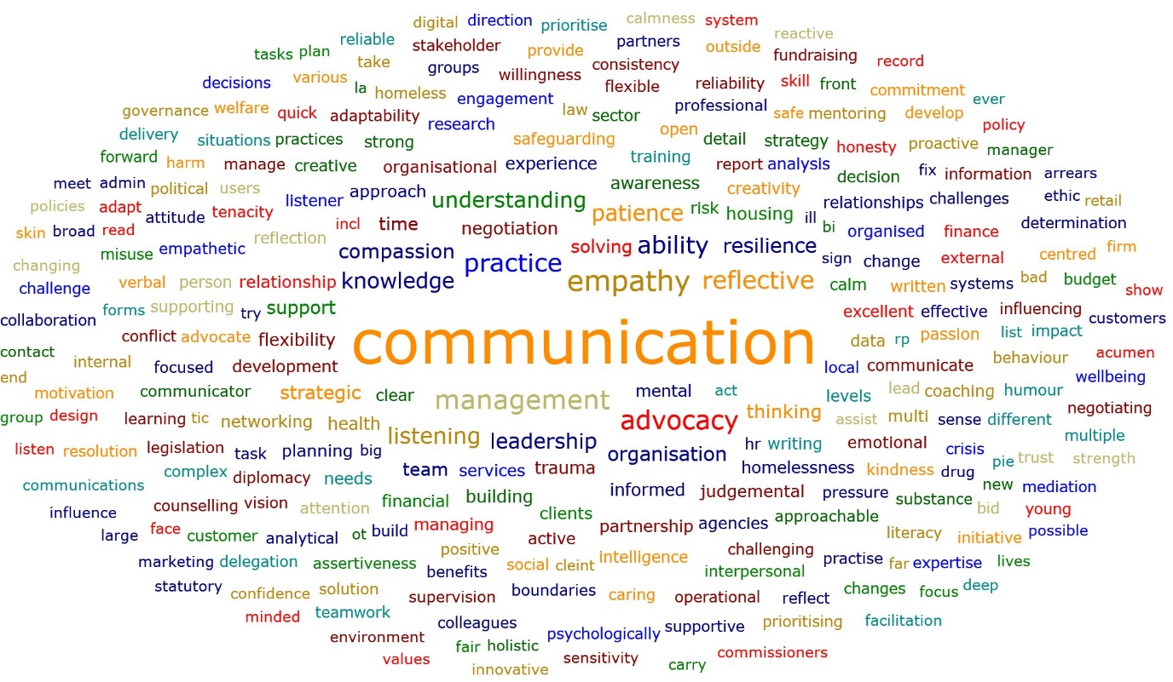
4. What…
skills do staff need?
Notes:
Communication was the most prominent theme, mentioned by 72%.
It was the most popular theme across all roles, including: 76% of service managers, 72% of corporate / central, 71% of senior managers, 69% of frontline staff, and 50% of CEOs.
Compassion / empathy were the next most popular theme (26%), especially amongst frontline staff (38%), followed by service managers (23%), corporate / central staff (20%), senior managers (14%) and finally CEOs (8%).
These were followed by leadership (9%) and resilience (8%).
Leadership was very popular amongst CEOs (38%) and senior managers (23%), while
resilience was more popular amongst frontline staff (11%) and corporate / central (9%).

Slide 11
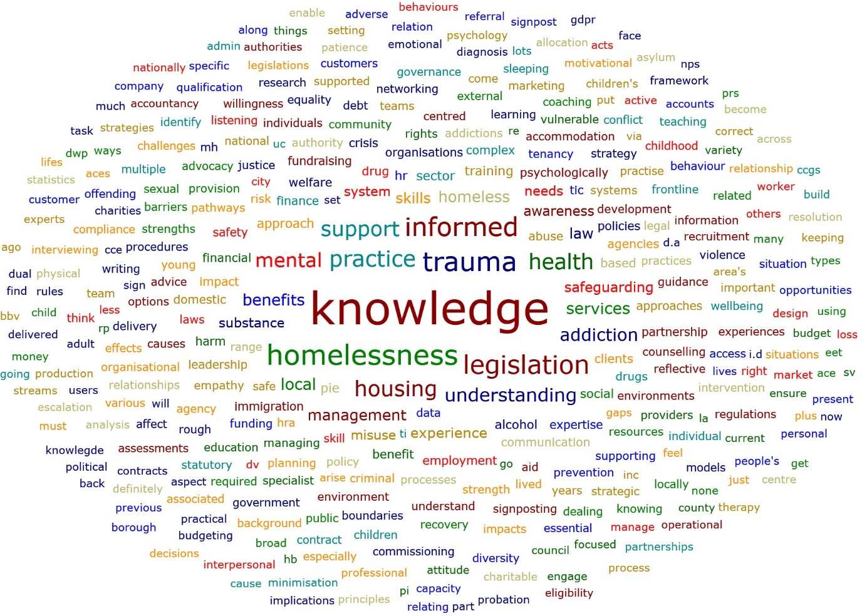
4. What…
expertise do staff need?
Notes:
Trauma informed care / a trauma informed approach was the most popular response (37%), followed by legislation (25%), substance use (24%) and health (21%).
A real focus on experience, knowledge gained through working (in the sector, but also ‘neighbouring’ sectors)

Slide 12
5. How…
hard is it to find & keep staff?
Hard to find high quality staff: 61% agree
Easy to keep high quality staff: 19% agree
The pandemic has not affected recruitment & retention: 21% agree
Notes:
When people do leave, how hard is it to find and keep staff?

Slide 13
5. How…
hard is it to find & keep staff?
We have had a higher than average turnover of staff over the past few years. Support Workers generally stay around a year - it takes around this amount of time to get someone well developed and skilled in their role. … I am in a constant cycle of recruitment which is time consuming and takes me away from other elements of my role. It impacts on the other team members as they have to work with bank/agency staff who are less experienced and therefore they end up having to do more. It impacts on [clients] as they … don't have consistent support. … We have noticed significantly lower levels of interest in roles in our team over the past couple of years. ... The impact of all of this is stress for those that are here and risk of burnout.

Slide 14
5. How…
hard is it to find & keep staff?
There is a lack of experienced staff as many exited the sector during the Covid-19 pandemic and subsequently, due to the relentless demands placed on staff. We are having to recruit staff with transferable skills but having to train them from scratch which takes both time and … resources which are spread very thinly.
I think a lot of … frontline workers who worked through Covid19 are 'burnt out' including myself. We constantly changed our services to meet demands always putting clients first and with retention of staff at a level I have never seen before … staff who stayed have picked up extra work as a result I feel i have nothing left to give.
Notes:
All of this was seen by many to have worsened during the pandemic, due to a combination of staff finding the periods of increased restrictions to be incredibly challenging and the opportunity for some to experience home working and prefer this or hybrid working.

Slide 15
5. What…
about the future?
It will become more difficult to recruit high quality staff: 59% agree
We will be able to retain high quality staff: 37% agree
Increasing cost of living will make it more difficult: 73% agree
Notes:
Thinking about their organisation over the next year

Slide 16
6. How…
are organisations trying to address these challenges?
Notes:
Lower caseloads and progression were 2 strategies few organisations had been able to use, but where many would like to
Ensuring staff are well paid, offering permanent contracts, and improving professional development offers were also very popular as areas that organisations wanted to try or said it had helped when they had
Flexible working, sense of purpose, and ensuring recognition for their work were the most popular areas organisations had tried and said it had helped
Improving benefits and annual pay increases were areas where of those who had tried it: more said it had helped than not, but this gap was smaller: more than 1 in 4 respondents said they had tried it and it had not helped
In all areas more than 50% either had tried it and thought it had helped or wanted to try it.

Slide 17
7. What…
do people think will help their career progression
Notes:
While organisations were unlikely to report having increased opportunities to progress to improve recruitment and retention, this was the strategy respondents were most likely to say would be helpful for their own career progression.
This was followed by accredited courses, opportunities to receive a qualification and training
All strategies were seen as potentially helpful by most respondents, though CV and cover letter builders and interview simulators were the least popular

Slide 18
7. What…
do people think will help their career progression
Organisation increased progression opportunities: 45%
…and it helped recruitment & retention: 75%
More progression opportunities would help my career: 88%

Slide 19
Key takeaways
Sector workers are likely to come into the sector because of their values and desire to make a positive difference.
While people agree a career in homelessness is rewarding, the ‘realities’ of working in the sector are the biggest challenge, especially low pay and high workloads.
Many state they face chronic staff shortages, due to a combination of high turnover rates, an inability to provide permanent contracts because of the lack of long-term funding, and funding shortages.
Most agree that staff shortages and recruitment and retention challenges negatively impact their ability to support those experiencing homelessness.
The pandemic and cost of living crisis have made and are likely to continue to make these challenges worse.
There are a lot of strategies that organisations say have helped, especially flexible working, sense of purpose, and ensuring recognition for their work.
Sector workers want more opportunities for career progression, including opportunities to take accredited courses, earn a qualification, or receive more training.

Slide 20
Questions?
Ask now!
Or get in touch at
trent.grassian@homelesslink.org.uk or research@homelesslink.org.uk

Slide 21
What we do
Homeless Link is the national membership charity for frontline homelessness services. We work to improve services through research, guidance and learning, and campaign for policy change that will ensure everyone has a place to call home and the support they need to keep it.
homeless.org.uk
@HomelessLink

Slide 22
Extra slides
Notes:
Similar trends across all roles
Though CEOs were more likely to indicate a desire to change the system and that it is an entrepreneurial sector
In addition:
Those more newly in their roles were more likely to cite values alignment and a pathway to a career in health / social care
Those in their role for 5+ years were the least likely to cite having lived experience as a reason

Slide 23
3. Why…
do people stay in the sector?
Notes:
Similar trends across all roles
Though CEOs were more likely to indicate a desire to change the system and that it is an entrepreneurial sector
In addition:
Those more newly in their roles were more likely to cite values alignment and a pathway to a career in health / social care
Those in their role for 5+ years were the least likely to cite having lived experience as a reason

